Slide 1
OPERATORS
Unary,Binary and Ternary Operators( Arithmetic,Relational,Bitwise,Logical)
Arithmetic Calculations
Operator Precedence

Slide 2
OPERATORS
Operators are special symbols that perform specific operations on one, two, or three operands, and then return a result.
There are several types of Operators in Java:
  The Simple Assignment Operator
  The Arithmetic Operators
  The Unary Operators
  The Equality and Relational Operators
  The Conditional Operators
  The Type Comparison Operator instanceof

Slide 3
The Simple Assignment Operator
Most common operators that you'll use is the simple assignment operator "=“,
it assigns the value on its right to the operand on its left:
int marks = 56;
int total = 100;
float percent = 56.0;

Slide 4
THE ARITHMETIC OPERATORS
Following arithmetic oprators are provided by Java:
+ additive operator (also used for
String concatenation)
- subtraction operator
* multiplication operator
/ division operator
% remainder operator

Slide 5
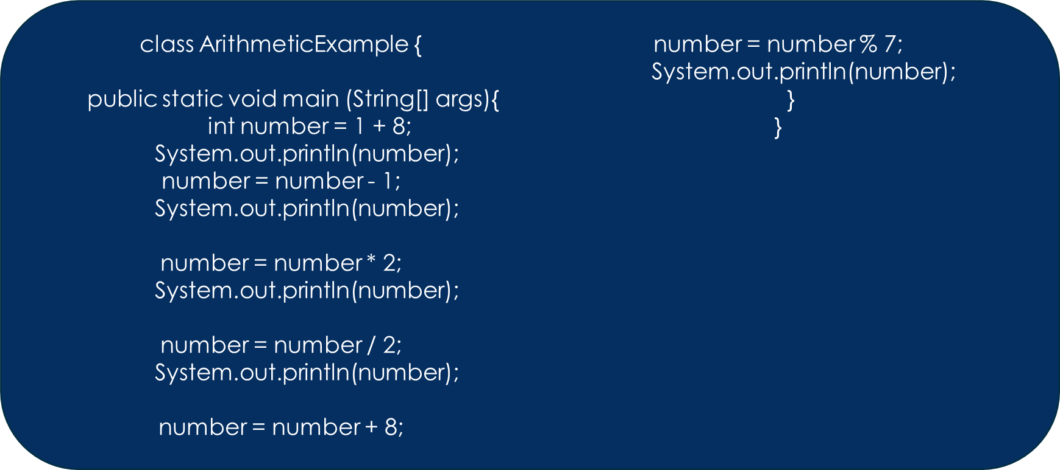
EXAMPLE

Slide 6
THE UNARY OPERATORS
The unary operators require only one operand; they perform various operations such as incrementing/decrementing a value by one, negating an expression, or inverting the value of a Boolean.
+ Unary plus operator; indicates positive value (numbers are positive without this, however)
- Unary minus operator; negates an expression
++ Increment operator; increments a value by 1
-- Decrement operator; decrements a value by 1
! Logical complement operator;
inverts the value of a boolean

Slide 7
THE EQUALITY AND RELATIONAL OPERATORS
The equality and relational operators determine if one operand is greater than, less than, equal to, or not equal to another operand.
Also known as Comparison Operators
  int number1 = 1;
  int number2 = 2;
  System.out.println(number1 == number2);
  System.out.println(number1 != number2);
  System.out.println(number1 > number2);
  System.out.println(number1 < number2);
  System.out.println(number1 <= number2);
Operator
== | Equal to
!= | Not equal to
> | Greater
>= | Greater than or equal to
< | Less than
<= | Less than or equal to

Slide 8
THE CONDITIONAL OPERATORS
The && and || operators perform Conditional-AND and Conditional-OR operations on two boolean expressions. These operators exhibit "short-circuiting" behavior, which means that the second operand is evaluated only if needed.
  int number1 = 1;
  int number2 = 2;
  System.out.println((number1 == 1) && (number2 == 2));
  System.out.println((number1 == 1) || (number2 == 1));

Slide 9
TERNARY OPERATOR ‘?:’
Another conditional operator is ? : , which can be thought of as shorthand for an if-then-else statement
It is called ternary because it uses three operands.
  int number1 = 1;
  int number2 = 2;
  String s = number1>1 ? “Greater than one” : “Less than one”;
  System.out.println(s);

Slide 10
OPERATOR PRECEDENCE
Operators can be combined into complex expressions
result = total + count / max - offset;
Operators have a well-defined precedence which determines the order in which they are evaluated
DMAS(Division Multiplication Addition Subtraction) rule is applied in Java Operator Precedence
Multiplication, division, and remainder are evaluated prior to addition, subtraction, and string concatenation
Arithmetic operators with the same precedence are evaluated from left to right, but parentheses can be used to force the evaluation order

Slide 11
OPERATOR PRECEDENCE
What is the order of evaluation in the following expressions?
a + b + c + d + e
a + b * c - d / e
1
2
3
4
3
2
4
1
a / (b + c) - d % e
int a=3,b=3,c=3,d=3,e=3;
int f = a + b * c - d / e;
System.out.println(f);
OUTPUT????
2
1
4
3
a / (b * (c + (d - e)))
4
3
2
1

Slide 12
OPERATOR PRECEDENCE
The operators in the following table are listed according to precedence order. The closer to the top of the table an operator appears, the higher its precedence
Operators | Precedence
postfix | expr++ expr--
unary | ++expr --expr +expr -expr ~ !
multiplicative | * / %
additive | + -
shift | << >> >>>
relational | < > <= >= instanceof
equality | == !=
bitwise AND | &
bitwise exclusive OR | ^
bitwise inclusive OR | |
logical AND | &&
logical OR | ||
ternary | ? :
assignment | = += -= *= /= %= &= ^= |= <<= >>= >>>=

